Slide 1


Introduction to Operating Systems
Introduction
ILIA STATE UNIVERSITY
Paata Gogishvili
Doctor of Informatics
Associate Professor
School of Technology
October 4, 2023
Faculty of Business, Technology and Education

Slide 2
Lecture Topics
GNU+Linux,
concept of the root and a regular user,
permissions,
environment and environment variables,
ssh protocol
ILIA STATE UNIVERSITY

Slide 3
Freedom
Freedom is the ability to make decisions for ourselves. We’re free to think and speak our minds, to choose our own path in life, and to associate with anyone we want. This allows us to be individual and create our own unique life. That’s why freedom is such a basic human right – without it, we couldn’t truly be ourselves. And that would be a pretty bleak world indeed.
Each of us want to be free in our decisions, actions, but we have some restrictions in our life.
ILIA STATE UNIVERSITY

Slide 4
Free Software
Not everything are free in our life:
In order to paint, we need brush, paint, canvas or paper...
Or
Computer, drawing tab, software, ... are needed…
In digital world is the same, for example - there are no free hardware for us.
But there are bunch of good software available for free! Free software gives us opportunity to do implement our ideas freely.
ILIA STATE UNIVERSITY

Slide 5
GNU
GNU is an operating system that is free software, it respects users' freedom. The GNU operating system consists of GNU packages (programs specifically released by the GNU Project) as well as free software released by third parties. The development of GNU made it possible to use a computer without software that would trample your freedom.
The GNU project was launched in 1983 by Richard Stallman, with the goal of creating a free and open-source operating system that could replace proprietary operating systems like Unix.
GNU is an extensive collection of free software (383 packages as of January 2022), which can be used as an operating system or can be used in parts with other operating systems. The use of the completed GNU tools led to the family of operating systems popularly known as Linux.
https://www.gnu.org
ILIA STATE UNIVERSITY

Slide 6
Philosophy of the GNU Project
Free software means that the software's users have freedom. (The issue is not about price.) We developed the GNU operating system so that users can have freedom in their computing.
Specifically, free software means users have the four essential freedoms: (0) to run the program, (1) to study and change the program in source code form, (2) to redistribute exact copies, and (3) to distribute modified versions.
Software differs from material objects—such as chairs, sandwiches, and gasoline—in that it can be copied and changed much more easily. These facilities are why software is useful; we believe a program's users should be free to take advantage of them, not solely its developer.
ILIA STATE UNIVERSITY

Slide 7


GNU Linux
Linux was created by Linus Torvalds in the early 1990s as an alternative to proprietary operating systems like Unix (developed in the 1970s by researchers at Bell Labs).
Linux is open source software, meaning that it is freely available for anyone to use, modify, and distribute.
While the Linux kernel was created separately, it was combined with the GNU software to create a complete operating system that is commonly referred to as "GNU/Linux" or simply "Linux."
ILIA STATE UNIVERSITY
Feel Free to touch the Linux
GNU

Slide 8
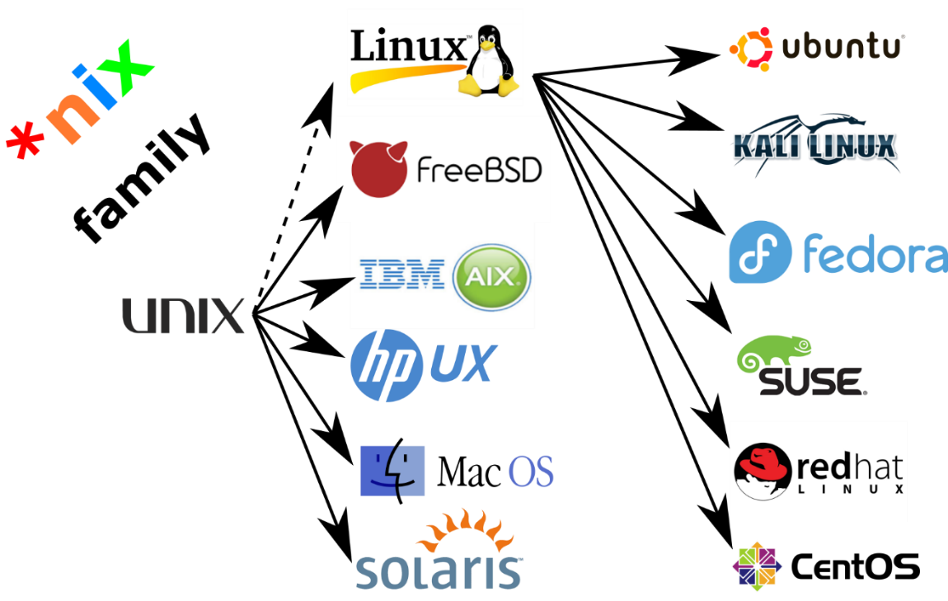
*NIX OS Family
The *NIX OS family, often pronounced as "nix" or "nix-like," refers to a family of operating systems that are Unix-like in nature. These operating systems share common design principles, concepts, and features inspired by the original Unix operating system, which was developed at AT&T's Bell Labs in the late 1960s.
ILIA STATE UNIVERSITY

Slide 9
*NIX OS Family
Multi-User and Multi-Tasking: *NIX operating systems are designed to support multiple users and multiple processes (tasks) running concurrently. This capability is essential for efficient server operations and time-sharing on multi-user systems.
Hierarchical File System: *NIX systems typically use a hierarchical file system, where files and directories are organized in a tree-like structure. This makes it easy to navigate and manage files and directories.
Command-Line Interface (CLI): *NIX systems often provide a powerful command-line interface, which is a text-based way to interact with the operating system. Users can enter commands and scripts to perform various tasks, which is a distinguishing feature of these systems.
Shell: A shell is a command-line interpreter that allows users to interact with the operating system. Common shells in *NIX systems include Bash, Zsh, and tcsh, among others. They provide scripting capabilities, command history, and advanced text manipulation.
Security and Permissions: *NIX systems have robust security features, including user and group permissions, which allow administrators to control access to files and resources. This is crucial for ensuring data security and system integrity.
Networking: *NIX operating systems have strong networking capabilities, making them well-suited for server environments. They include support for TCP/IP networking, which is the foundation of the internet.
ILIA STATE UNIVERSITY

Slide 10
Root and a regular user
The concept of a root user and a regular user is related to the management and control of computer systems, especially in the context of operating systems such as Linux and Unix.
the root user is the most powerful user on a system, with the ability to perform any task or make any change, while a regular user has limited access and permissions.
ILIA STATE UNIVERSITY

Slide 11
Root User
The root user, also known as the superuser or administrator, is a special user account on a Unix-like operating system that has complete control over the system. This account has the highest level of access permissions and can perform any task, including system-wide configuration changes, installing and removing software, and managing user accounts.
The root user has access to all system files and directories and can modify or delete them as needed. This level of access is necessary for performing tasks that require elevated privileges, such as system maintenance, software updates, and troubleshooting.
It is recommended to use the root user account only when absolutely necessary, and to use a regular user account for day-to-day tasks.
ILIA STATE UNIVERSITY

Slide 12
Regular user
Regular users are usually created for individuals who need access to the system but do not require the ability to make system-wide changes.
Regular users can perform tasks like accessing files, running programs, and creating and editing documents, but they are not allowed to make system-wide changes or modify system files without first obtaining the necessary permissions from an administrative user.
Regular users typically have their own home directory where they can store and manage their files and settings. They can also execute commands and run programs that are installed on the system.
In summary, regular users are essential for everyday usage of a Linux system and help to maintain system security by limiting the scope of actions that can be performed without administrative privileges.
ILIA STATE UNIVERSITY

Slide 13
Permissions
Permissions are the “rights” to act on a file or directory. The basic rights are read, write, and execute.
Read: a readable permission allows the contents of the file to be viewed. A read permission on a directory allows you to list the contents of a directory.
Write: a write permission on a file allows you to modify the contents of that file. For a directory, the write permission allows you to edit the contents of a directory (e.g. add/delete files).
Execute: for a file, the executable permission allows you to run the file and execute a program or script. For a directory, the execute permission allows you to change to a different directory and make it your current working directory. Users usually have a default group, but they may belong to several additional groups.
ILIA STATE UNIVERSITY

Slide 14
Encoding of read, write and execute
Read, write and execute permissions are encoded in 3 bits.
1 means, that action is allowed
0 means, that action is not allowed
For example – 100 means, that only read is allowed, writing and executing are not allowed.
File and folder has 3 types of access:
Access for owner of that file or directory
Access for group of owner of that file or directory
Access for every other user
ILIA STATE UNIVERSITY

Slide 15
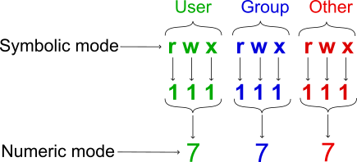
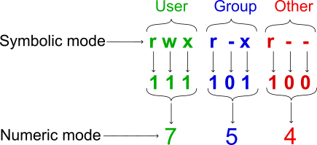
Encoding of read, write and execute
permissions (for owner, group and other users) of the file or folder
numeric | symbolic | binary
7 | rwx | 111
6 | rw- | 110
5 | r-x | 101
4 | r-- | 100
3 | -wx | 011
2 | -w- | 010
1 | --x | 001
0 | --- | 000
chmod 754 <file name>
ILIA STATE UNIVERSITY

Slide 16
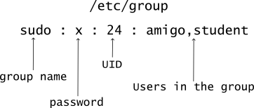
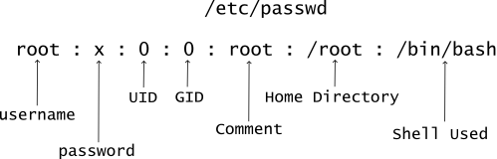
Users and Groups
User can be member of Group(s). Information about users and groups can be found in files /etc/passwd and /etc/group respectively.
ILIA STATE UNIVERSITY

Slide 17
Environment and Variables
Environment variables or ENVs basically define the behavior of the environment. They can affect the processes ongoing or the programs that are executed in the environment.
Scope of any variable is the region from which it can be accessed or over which it is defined. An environment variable in Linux can have global or local scope.
A globally scoped ENV that is defined in a terminal can be accessed from anywhere in that particular environment which exists in the terminal. That means it can be used in all kind of scripts, programs or processes running in the environment bound by that terminal.
A locally scoped ENV that is defined in a terminal cannot be accessed by any program or process running in the terminal. It can only be accessed by the terminal( in which it was defined) itself.
ILIA STATE UNIVERSITY

Slide 18
Environment and Variables
Use command printenv in order to view all environmental variables.
Use echo <variable name> in order to view value of the variable. For example, use echo $PATH in order to view path variable.
If we want to delete some variable, we can use unset <variable name> command. Please note, that always do tests on your test variables!
ILIA STATE UNIVERSITY

